Slide 1
Coding groups
Entry question:
How could coding help us check our work from yesterday?
Assign student groups.
Group 1: Group 2: Group 3: Group 4:
Notes:
Andre
Brooklyn
Isaac
Jessica
Angel

Slide 2
Welcome to Coding week!
Be Leaders, co facilitators
Be determined
Be diverse
Show teamwork! = share the trackpad and the keyboard, everyone tries!

Slide 3
Be respectful
Be on task
Everything is recorded!

Slide 4

Introduction to Variables
Assignment: understanding comments and variables
Print different numbers by storing them in a variable

Slide 5

Strings
Assignment: understanding strings
Print different messages by storing them in a string

Slide 6
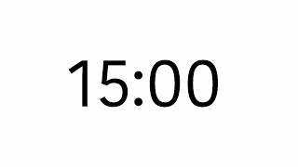
Video interpretation
Complete the front and back questions on the handout for the example video
Pay attention to the mathematical thinking that is behind the video!

Slide 7
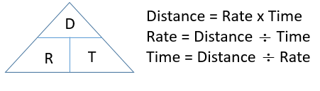
Computing Rates
#1 Assignment: understanding rates
Solve the problems in #1 using tables or rules
Start #2 if you finish early
Hours | Kilometers
3 | 236
•78.6
Notes:
Change directions to finding the constant or the rate for each situation
Add title or units to answer

Slide 8
Computing Rates
Assignment: understanding rates
Solve the problems in #1 using the coding
Notes:
Change directions to finding the constant or the rate for each situation
Add title or units to answer

Slide 9
Computing Rates
Assignment: Compute distances from rates
Solve the problems in #2 using the coding

Slide 10
Computing Rates
Assignment: Compute times from rates
Solve the problems in #3 using the coding

Slide 11
Working with Lists
Assignment: Print a list
Assignment: Print a list of strings

Slide 12
Name: Date:
Things I learned about coding: | Things I learned about Math (distance, rate, time, equations)

